Slide 1
AVIATION
DATA
PHASE 1 PROJECT

Slide 2
BUSINESS PROBLEM
Your company is expanding in to new industries to diversify its portfolio. Specifically, they are interested in purchasing and operating airplanes for commercial and private enterprises, but do not know anything about the potential risks of aircraft. You are charged with determining which aircraft are the lowest risk for the company to start this new business endeavor. You must then translate your findings into actionable insights that the head of the new aviation division can use to help decide which aircraft to purchase.

Slide 3
DATASET USED
Aviation Accident Database
www.kaggle.com

Slide 4
DATA UNDERSTANDING
Key Data Fields | Data Contained | Business Questions
Aircraft.Damage | The severity of damage to the aircraft: Destroyed / Substantial / Minor | Which aircraft are the most durable?
Make | The manufacturer of the aircraft | Which manufacturer makes the safest planes?
Model | The model of the aircraft | Which model is the safest?
Injury Columns | Total Fatal / Serious / Minor Injuries | How many passengers were injured and how serious were their injuries?
Engine.Type | The type of engine used in the aircraft | Is there a correlation between engine type and severity of the accident?
Num.of.Engines | The number of engines on the aircraft | Is there a correlation between the number of engines and severity of the accident?

Slide 5
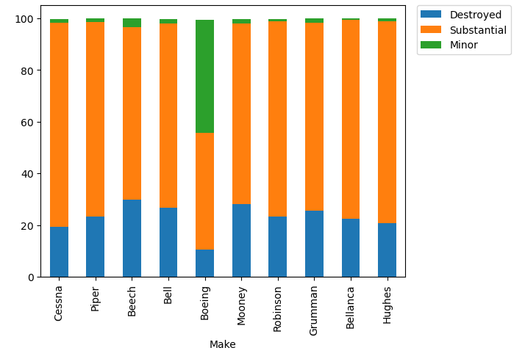
DAMAGE BY MAKE
Beech has the highest % of destroyed aircrafts
Bell has the highest % of substantially damaged aircrafts
Boeing seems to have the safest planes with the highest % of minor damage

Slide 6
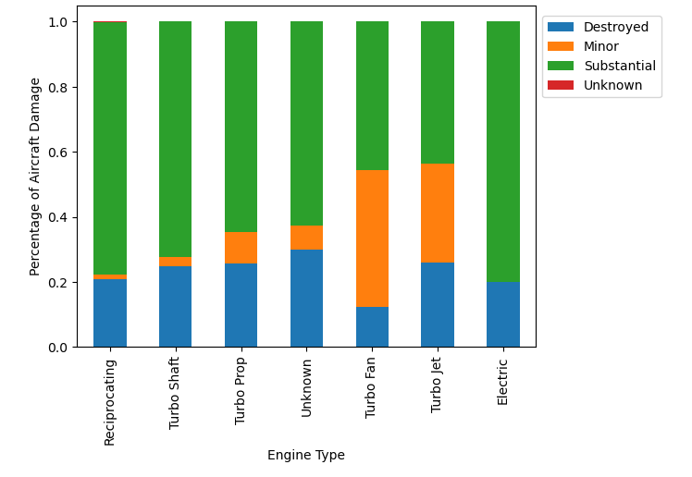
DAMAGE BY ENGINE TYPE
Turbo Fan and Turbo Jet have by far the highest percentage of minor aircraft damage
Electric Engine seems the most dangerous with the highest percentage of substantial damage

Slide 7
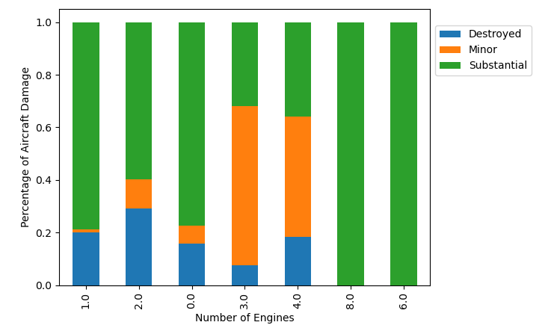
DAMAGE BY NUMBER OF ENGINE
Turbo Fan and Turbo Jet have by far the highest percentage of minor aircraft damage
Reciprocating seem the most dangerous with the highest percentage of substantial damage

Slide 8
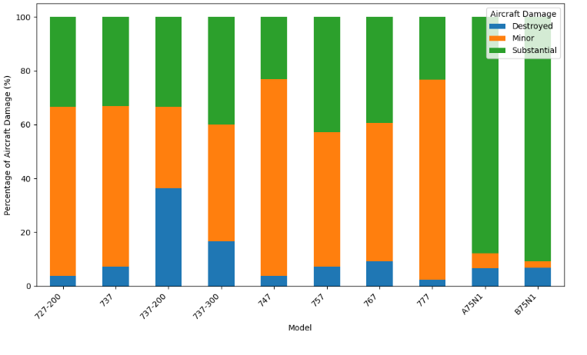
Diving Deeper Into Boeing
The 777 model has the highest % of minor damage
The 747 model has the 2nd highest % of minor damage
The 737-200 model has the highest destroyed %

Slide 9
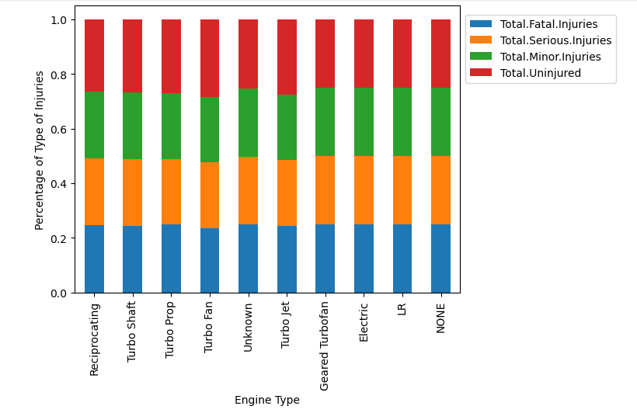
EXPLORING CORRELATION BETWEEN ENGINE TYPES AND SEVERITY OF ACCIDENT
There seems to be little difference in the % of injuries sustained across Engine Type

Slide 10
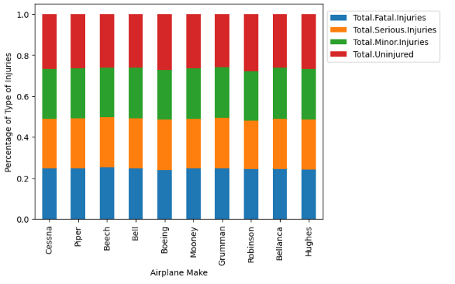
INJURIES COMPARED TO AIRCRAFT MAKE
There seems to be little difference in the % of injuries sustained across airplane makes

Slide 11
RECOMMENDATION
I recommend focusing on Boeing aircraft, specifically the 777 models, equipped with Turbo Fan and Turbo Jet engines, and featuring 3-4 engines. This recommendation is based on four key findings from our analysis:
1. Boeing aircraft have the lowest percentage of destroyed aircraft compared to other manufacturers.
2. The 777 models exhibit the lowest percentage of destroyed and substantially damaged aircraft among Boeing models.
3. Turbo Fan and Turbo Jet engines show the lowest percentage of destroyed aircraft.
4. Planes with 3-4 engines have the lowest percentage of destroyed or substantially damaged aircraft.

